Slide 1

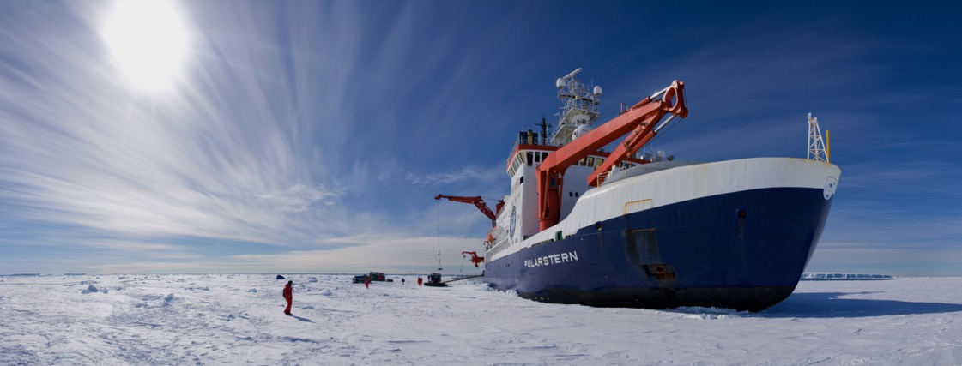
Largest Arctic research expedition ever
>100 Mio€ budget
more than 60 institutions
16 nations
Strong partnership between Germany, Russia, USA, China, UK, Norway, Canada led by AWI

Slide 2
Team Ice 1
Team Ice 2
Team Snow
Team Melt
Team Radar

Slide 3
16
15
14
13
12
11
10
9
8
7
6
5
4
3
2
1
Team Ice 1
Measure sea ice thickness at
ten locations
A B C D E F G H I J K L M N O P Q R S

Slide 4
16
15
14
13
12
11
10
9
8
7
6
5
4
3
2
1
Team Ice 1
H1 = 2.5 m
A B C D E F G H I J K L M N O P Q R S

Slide 5
16
15
14
13
12
11
10
9
8
7
6
5
4
3
2
1
Team Ice 1
H1 = 2.0 m
A B C D E F G H I J K L M N O P Q R S

Slide 6
16
15
14
13
12
11
10
9
8
7
6
5
4
3
2
1
Team Ice 1
H1 = 2.5 m
A B C D E F G H I J K L M N O P Q R S

Slide 7
16
15
14
13
12
11
10
9
8
7
6
5
4
3
2
1
Team Ice 1
H1 = 1.5 m
A B C D E F G H I J K L M N O P Q R S

Slide 8
16
15
14
13
12
11
10
9
8
7
6
5
4
3
2
1
Team Ice 1
H1 = 2.0 m
A B C D E F G H I J K L M N O P Q R S

Slide 9
16
15
14
13
12
11
10
9
8
7
6
5
4
3
2
1
Team Ice 1
H1 = 2.5 m
A B C D E F G H I J K L M N O P Q R S

Slide 10
16
15
14
13
12
11
10
9
8
7
6
5
4
3
2
1
Team Ice 1
H1 = 3.0 m
A B C D E F G H I J K L M N O P Q R S

Slide 11
16
15
14
13
12
11
10
9
8
7
6
5
4
3
2
1
Team Ice 1
H1 = 2.0 m
A B C D E F G H I J K L M N O P Q R S

Slide 12
16
15
14
13
12
11
10
9
8
7
6
5
4
3
2
1
Team Ice 1
H1 = 2.5 m
A B C D E F G H I J K L M N O P Q R S

Slide 13
16
15
14
13
12
11
10
9
8
7
6
5
4
3
2
1
Team Ice 1
H1 = 3.0 m
A B C D E F G H I J K L M N O P Q R S

Slide 14
16
15
14
13
12
11
10
9
8
7
6
5
4
3
2
1
B. Team Ice 2
Measure sea ice thickness at
ten locations
A B C D E F G H I J K L M N O P Q R S

Slide 15
16
15
14
13
12
11
10
9
8
7
6
5
4
3
2
1
B. Team Ice 2
H1 = 1.0 m
H2 = 0.5 m
…etc
A B C D E F G H I J K L M N O P Q R S

Slide 16
16
15
14
13
12
11
10
9
8
7
6
5
4
3
2
1
C. Team Snow
Measure snow
thickness over 1 km
A B C D E F G H I J K L M N O P Q R S

Slide 17
16
15
14
13
12
11
10
9
8
7
6
5
4
3
2
1
C. Team Snow
S1 = 20 cm
S2 = 15 cm
S3 = 10 cm
…
S8 = 20 cm
S9 = 25 cm
S10 = 15 cm
A B C D E F G H I J K L M N O P Q R S

Slide 18
16
15
14
13
12
11
10
9
8
7
6
5
4
3
2
1
D. Team Melt
When will the camp
be entirely covered with ponds?
A B C D E F G H I J K L M N O P Q R S

Slide 19
16
15
14
13
12
11
10
9
8
7
6
5
4
3
2
1
D. Team Melt
= 1 square
Total = 1 square
A B C D E F G H I J K L M N O P Q R S

Slide 20
16
15
14
13
12
11
10
9
8
7
6
5
4
3
2
1
D. Team Melt
= 1 square
= 4 squares
Total = 5 squares
A B C D E F G H I J K L M N O P Q R S

Slide 21
16
15
14
13
12
11
10
9
8
7
6
5
4
3
2
1
D. Team Melt
= 1 square
= 4 squares
= 1 square
Total = 6 squares
A B C D E F G H I J K L M N O P Q R S

Slide 22
16
15
14
13
12
11
10
9
8
7
6
5
4
3
2
1
D. Team Melt
= 1 square
= 4 squares
= 1 square
= 4 squares
Total = 10 squares
A B C D E F G H I J K L M N O P Q R S

Slide 23
16
15
14
13
12
11
10
9
8
7
6
5
4
3
2
1
D. Team Melt
= 1 square
= 4 squares
= 1 square
= 4 squares
= 1 square
Total = 11 squares
A B C D E F G H I J K L M N O P Q R S

Slide 24
16
15
14
13
12
11
10
9
8
7
6
5
4
3
2
1
D. Team Melt
= 1 square
= 4 squares
= 1 square
= 4 squares
= 1 square
= 9 squares
Total = 20 squares
A B C D E F G H I J K L M N O P Q R S

Slide 25
16
15
14
13
12
11
10
9
8
7
6
5
4
3
2
1
E. Team Radar
Measure sea ice thickness in no go area
with satellite data
A B C D E F G H I J K L M N O P Q R S

Slide 26
16
15
14
13
12
11
10
9
8
7
6
5
4
3
2
1
E. Team Radar
A B C D E F G H I J K L M N O P Q R S

Slide 27
16
15
14
13
12
11
10
9
8
7
6
5
4
3
2
1
E. Team Radar
A B C D E F G H I J K L M N O P Q R S

Slide 28
16
15
14
13
12
11
10
9
8
7
6
5
4
3
2
1
E. Team Radar
A B C D E F G H I J K L M N O P Q R S

Slide 29
16
15
14
13
12
11
10
9
8
7
6
5
4
3
2
1
E. Team Radar
A B C D E F G H I J K L M N O P Q R S

Slide 30
16
15
14
13
12
11
10
9
8
7
6
5
4
3
2
1
E. Team Radar
A B C D E F G H I J K L M N O P Q R S

Slide 31
16
15
14
13
12
11
10
9
8
7
6
5
4
3
2
1
E. Team Radar
A B C D E F G H I J K L M N O P Q R S

Slide 32
16
15
14
13
12
11
10
9
8
7
6
5
4
3
2
1
E. Team Radar
A B C D E F G H I J K L M N O P Q R S

Slide 33
16
15
14
13
12
11
10
9
8
7
6
5
4
3
2
1
E. Team Radar
A B C D E F G H I J K L M N O P Q R S

Slide 34
16
15
14
13
12
11
10
9
8
7
6
5
4
3
2
1
E. Team Radar
A B C D E F G H I J K L M N O P Q R S

Slide 35
16
15
14
13
12
11
10
9
8
7
6
5
4
3
2
1
E. Team Radar
A B C D E F G H I J K L M N O P Q R S

Slide 36
16
15
14
13
12
11
10
9
8
7
6
5
4
3
2
1
E. Team Radar
A B C D E F G H I J K L M N O P Q R S

Slide 37
15 10 5 10
16
15
14
13
12
11
10
9
8
7
6
5
4
3
2
1
E. Team Radar
20 15 10 5
20 15 15 20
Average snow thickness in radar footprint:
(15 + 10 + 5 + 10 + 20 + 15 + 10 + 5 + 20 + 15 + 15 + 20) = S
S / 12 = ?
A B C D E F G H I J K L M N O P Q R S

Slide 38
1.5 1.0 0.5 1.0
16
15
14
13
12
11
10
9
8
7
6
5
4
3
2
1
E. Team Radar
2.0 1.5 1.0 3.5
3.0 2.5 1.5 2.0
Average ice thickness in radar footprint:
(1.5 + 1.0 + 0.5 + 1.0 + 2.0 + 1.5 + 1.0 + 3.5 + 3.0 + 2.5 + 1.5 + 2.0) = I
I / 12 = ?
A B C D E F G H I J K L M N O P Q R S

Slide 39
1.5 1.0 0.5 1.0
16
15
14
13
12
11
10
9
8
7
6
5
4
3
2
1
E. Team Radar
2.0 1.5 1.0 3.5
3.0 2.5 1.5 2.0
Average ice thickness in radar footprint:
(1.5 + 1.0 + 0.5 + 1.0 + 2.0 + 1.5 + 1.0 + 3.5 + 3.0 + 2.5 + 1.5 + 2.0) / 12 = ?
A B C D E F G H I J K L M N O P Q R S

